Slide 1

Visual Question-Answering
Team Members:
Abdalla Shaaban Elsayed
Rabah Jamal Mohammed Ali
Abdullah Abdelkader Roshdy
Abdullah Mahmoud Abdullah
Supervisor:
Dr\ Sally Saad
TA\ Ahmed Salah
1

Slide 2
Outline
Introduction
Problem definition
Working Phases
Progress
Time Plan
Tools
References
2

Slide 3
Outline
Introduction
3

Slide 4
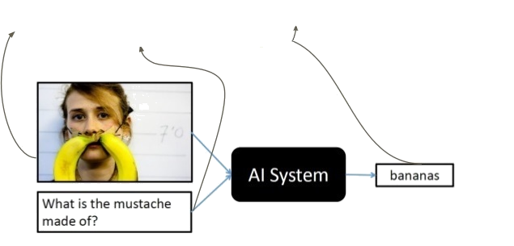
Introduction​
Question-Answering
Visual
Predict the Answer of a given question related to an image.
4

Slide 5
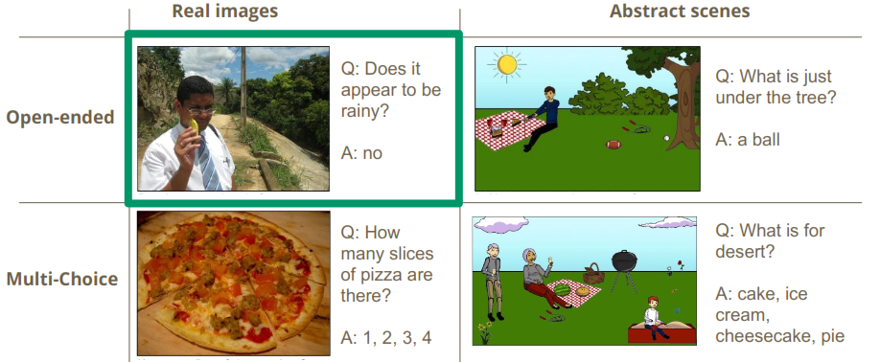
Types of Visual Question-Answering
5

Slide 6
Outline
Introduction
Problem definition
6

Slide 7
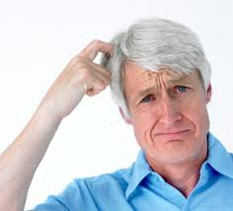
Problem definition
How to build a model that extract feature of an image related
to a given question ?
7

Slide 8
Outline
Introduction
Problem definition
Working Phases
8

Slide 9
Phases Diagram
Data Preprocessing
Model Building
Model Testing and Validation
Model Interface
9

Slide 10
Phases Diagram
Data Preprocessing
10

Slide 11
Phases overview | Data preprocessing
Gathering Datasets
VQA Dataset
6,141,630 question-answers pairs.
COCO-QA Dataset
78,736 questions.
123,287 images.
Answer types including yes/no, number, and other.
184,612 images.
4 types of questions: object, number, color, location.
11
Notes:
COCO-QA:
Automatically generated from image captions.
123287 images
78736 train questions
38948 test questions
4 types of questions: object, number, color, location
Answers are all one-word.
91 category for train images
VQA:
248,349 training questions
121,512 validation questions
244,302 testing questions
101,434 test images

Slide 12
Phases overview | Data preprocessing
Preparing Dataset
Cleaning the dataset using NLTK.
Apply one hot-encoding for a given question.
12

Slide 13
Phases overview | Data preprocessing
Apply one hot-encoding for a given question (eg. “how many horses are there”):
[1, 0, 0, 0, 0] = how
[0, 1, 0, 0, 0] = many
[0, 0, 1, 0, 0] = horses
[0, 0, 0, 1, 0] = are
[0, 0, 0, 0, 1] = there
13

Slide 14
Phases Diagram
Data Preprocessing
Model Building
13

Slide 15
Phases overview | Model Building
Question
Word Embedding
Question Hierarchy
Co-Attention
Encoding for Predicting Answers
Image
CNN
Image Feature
14

Slide 16
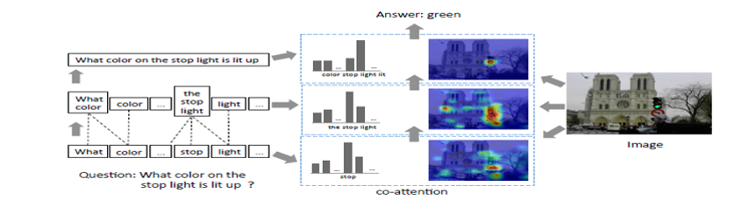
Phases overview | Model Building
Model over view
15

Slide 17
Phases overview | Model Building
Model over view
Words Level
15

Slide 18
Phases overview | Model Building
Model over view
Words Level
Phrases Level
15

Slide 19
Phases overview | Model Building
Model over view
Words Level
Phrases Level
Question Level
15

Slide 20
Phases overview | Model Building
Question
Image
16

Slide 21
Phases overview | Model Building
Question
Image
CNN
Image Feature
17

Slide 22
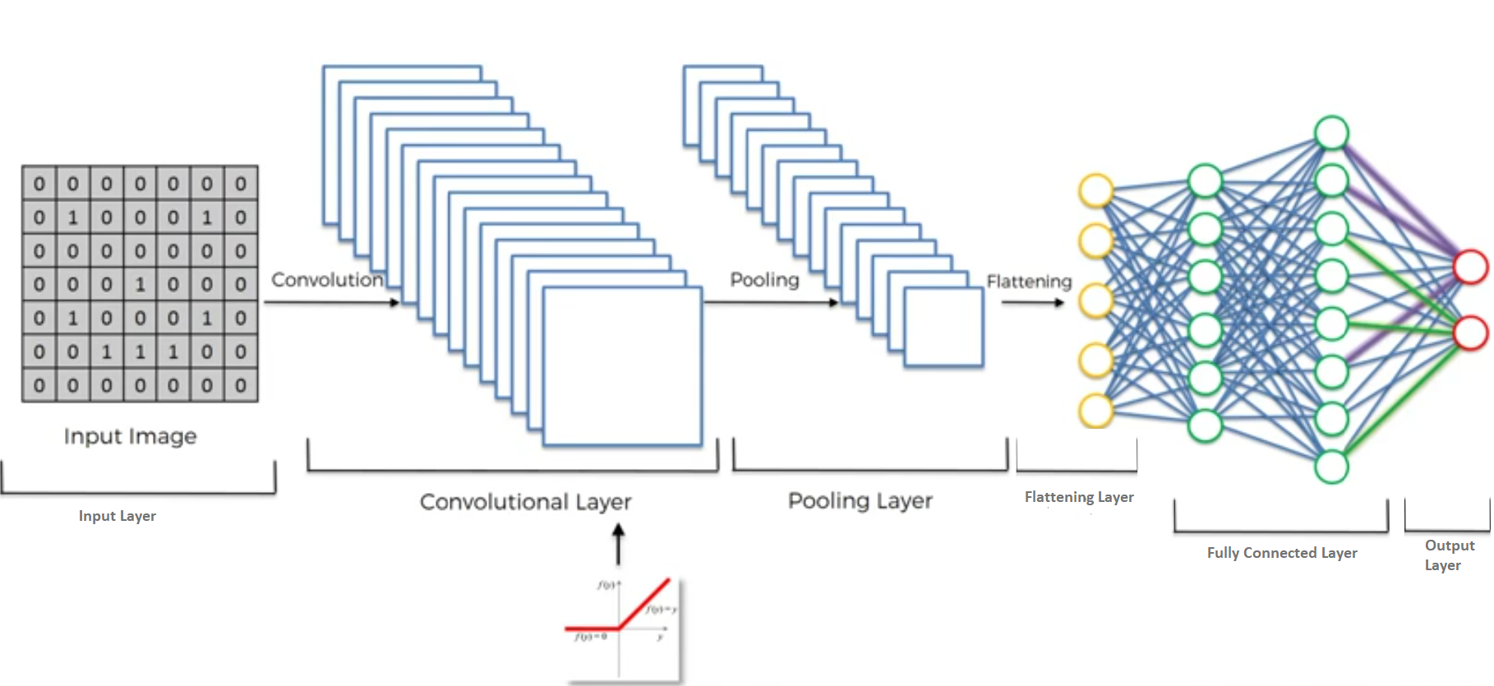
Phases overview | Model Building
Features Extraction of the image.
CNN Hierarchy
18

Slide 23
Phases overview | Model Building
Features Extraction of the image.
CNN Hierarchy
18

Slide 24
Phases overview | Model Building
Features Extraction of the image.
CNN Hierarchy
18

Slide 25
Phases overview | Model Building
Features Extraction of the image.
CNN Hierarchy
Non-Linear Function (RELU)
18

Slide 26
Phases overview | Model Building
Features Extraction of the image.
CNN Hierarchy
18

Slide 27
Phases overview | Model Building
Features Extraction of the image.
CNN Hierarchy
18

Slide 28
Phases overview | Model Building
Features Extraction of the image.
CNN Hierarchy
18

Slide 29
Phases overview | Model Building
Features Extraction of the image.
CNN Hierarchy
18

Slide 30
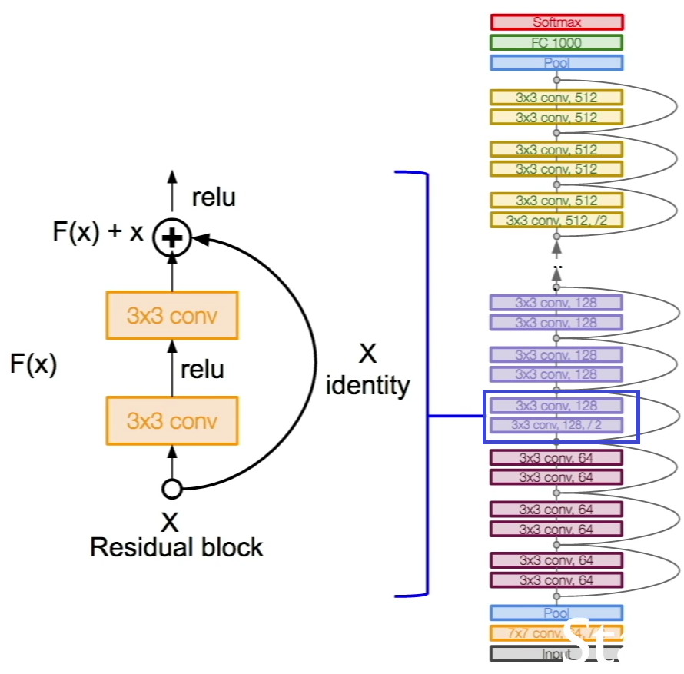
Phases overview | Model Building
Features Extraction of the image.
ResNet CNN Hierarchy
Published 2015.
Huge Number of Layers(100 ,…..,1000).
Use 3 x 3 Conv Window.
19

Slide 31
Phases overview | Model Building
Features Extraction of the image.
rescale the image to 448 X 448
20

Slide 32
Phases overview | Model Building
Features Extraction of the image.
rescale the image to 448 X 448
We input the image to ResNet.
20

Slide 33
Phases overview | Model Building
Features Extraction of the image.
rescale the image to 448 X 448
We input the image to ResNet.
We take the activation from the last pooling layer of ResNet as its feature
20

Slide 34
Phases overview | Model Building
Question
Word Embedding
Question Hierarchy
Image
CNN
Image Feature
21

Slide 35
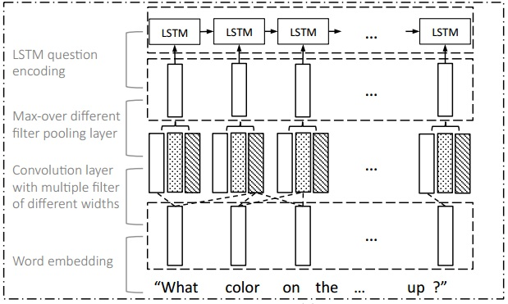
Phases overview | Model Building
Question Hierarchy
22

Slide 36
Phases overview | Model Building
Question Hierarchy
Word Level
22

Slide 37
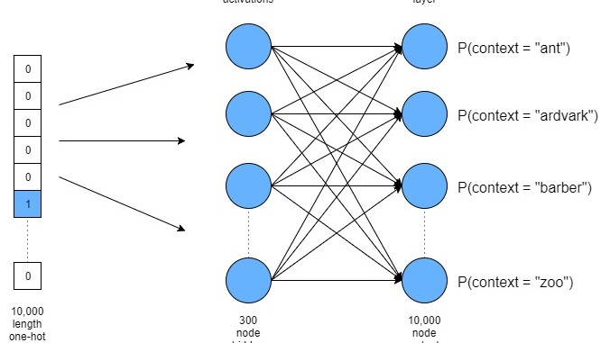
Phases overview | Model Building
Question Hierarchy
Word Level
Word embedding : A technique to embed the words to vector space , so that the words which have similar or close meaning have close vectors .
23

Slide 38
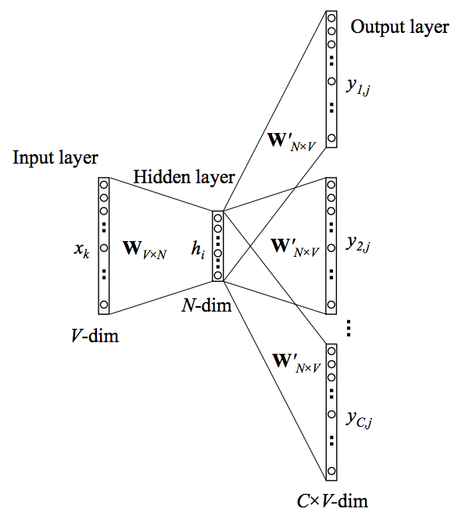
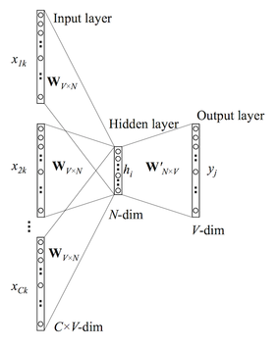
Phases overview | Model Building
Question Hierarchy
Word Level
Word embedding Models : Skip-gram & Continuous Bag of Words (CBOW)
24

Slide 39
Phases overview | Model Building
Question Hierarchy
Word Level
Phrase Level
25

Slide 40
Phases overview | Model Building
Question Hierarchy
Phrase Level
To compute the phrase features , we apply 1-D convolution on the word embedding vectors
The convolution and max-pooling processes exploit and summarize the local relation signals between consecutive words.
max-pooling layer :
is utilized to extract most informative features from among convolutions
maximizing the similarity between the context and the current word while minimizing the similarity between the context and all other negatively sampled words
26

Slide 41
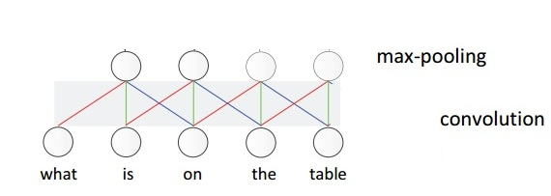
Phases overview | Model Building
Question Hierarchy
Phrase Level
The meaningful composition “ of the chair ” is more likely to be pooled out, compared with the composition “ front of the ”.
27

Slide 42
Phases overview | Model Building
Question Hierarchy
Phrase Level
The meaningful composition “ of the chair ” is more likely to be pooled out, compared with the composition “ front of the ”.
27

Slide 43
Phases overview | Model Building
Question Hierarchy
Phrase Level
The meaningful composition “ of the chair ” is more likely to be pooled out, compared with the composition “ front of the ”.
27

Slide 44
Phases overview | Model Building
Question Hierarchy
Phrase Level
The meaningful composition “ of the chair ” is more likely to be pooled out, compared with the composition “ front of the ”.
27

Slide 45
Phases overview | Model Building
Question Hierarchy
Phrase Level
The meaningful composition “ of the chair ” is more likely to be pooled out, compared with the composition “ front of the ”.
27

Slide 46
Phases overview | Model Building
Question Hierarchy
Phrase Level
The meaningful composition “ of the chair ” is more likely to be pooled out, compared with the composition “ front of the ”.
27

Slide 47
Phases overview | Model Building
Question Hierarchy
Phrase Level
The meaningful composition “ of the chair ” is more likely to be pooled out, compared with the composition “ front of the ”.
27

Slide 48
Phases overview | Model Building
Question Hierarchy
Phrase Level
The meaningful composition “ of the chair ” is more likely to be pooled out, compared with the composition “ front of the ”.
27

Slide 49
Phases overview | Model Building
Question Hierarchy
Phrase Level
The meaningful composition “ of the chair ” is more likely to be pooled out, compared with the composition “ front of the ”.
27

Slide 50
Phases overview | Model Building
Question Hierarchy
Phrase Level
The meaningful composition “ of the chair ” is more likely to be pooled out, compared with the composition “ front of the ”.
27

Slide 51
Phases overview | Model Building
Question Hierarchy
Word Level
Phrase Level
Question Level
28

Slide 52
Phases overview | Model Building
Question Hierarchy
Question Level
We use a LSTM to encode the sequence of phrase level after max-pooling. The corresponding question-level feature is the LSTM hidden vector at time t.
29

Slide 53
Phases overview | Model Building
Question
Word Embedding
Question Hierarchy
Co-Attention
Image
CNN
Image Feature
30

Slide 54
Phases overview | Model Building
Attention
Visual attention : given a text, which spatial location at image should we look at
Question attention : given an image, which part of the question should we look at
Co-attention : applying both of them
31

Slide 55
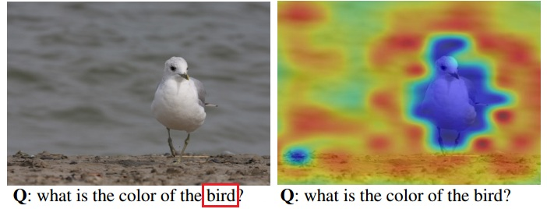
Phases overview | Model Building
Attention
Question Attention Visual attention
32

Slide 56
Phases overview | Model Building
Co - Attention
Alternating Co-Attention : In this attention mechanism, we sequentially alternate between generating image and question attention.
33

Slide 57
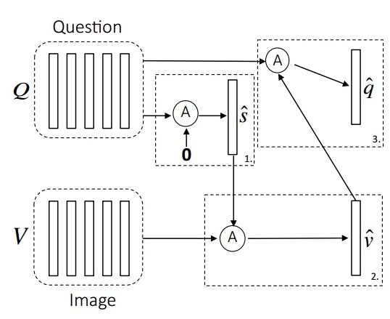
Phases overview | Model Building
Co - Attention
34

Slide 58
Phases overview | Model Building
Co - Attention
summarize the question into a single vector that is used to select spatial location of an image
35

Slide 59
Phases overview | Model Building
Co - Attention
Image feature related to question
36

Slide 60
Phases overview | Model Building
Co - Attention
Question embedded related to Image
37

Slide 61
Phases overview | Model Building
Question
Word Embedding
Question Hierarchy
Co-Attention
Encoding for Predicting Answers
Image
CNN
Image Feature
38

Slide 62
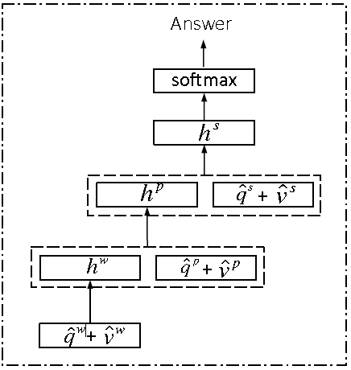
Phases overview | Model Building
Encoding for Predicting Answers
39

Slide 63
Phases overview | Model Building
Encoding for Predicting Answers
At word level obtain phrase level and enter the co-attention model to obtain attended image and question related to word
40

Slide 64
Phases overview | Model Building
Encoding for Predicting Answers
At phrase level obtain question level and enter the co-attention model to obtain attended image and question realted to phrase
41

Slide 65
Phases overview | Model Building
Encoding for Predicting Answers
At question level just enter the co-attention model to obtain attended image and question related to question
42

Slide 66
Phases overview | Model Building
Encoding for Predicting Answers
Soft max probability distribution for vocabulary
43

Slide 67
Phases Diagram
Data Preprocessing
Model Building
Model Testing and Validation
44

Slide 68
Phases overview | Model Testing
Measuring the system’s accuracy and the level of correctness of the predicted answers.
Enhancing the accuracy by experimenting different types of convolutional neural network to extract the image features
45

Slide 69
Phases Diagram
Data Preprocessing
Model Building
Model Testing and Validation
Model Interface
46

Slide 70
Phases overview | Interface
Build a user interface for the system, which allows the user to interact with the system.
Using Python’s framework with CSS and Javascript (optional).
47

Slide 71
Outline
Introduction
Problem definition
Working Phases
Progress
48

Slide 72
Progress
Stages finished:
Learning deep learning and basic NLP concepts.
Current Stage:
Gathering datasets: VQA and COCO-QA.
Problems faced:
Dealing with large image datasets.
49

Slide 73
Outline
Introduction
Problem definition
Working Phases
Progress
Time Plan
50

Slide 74
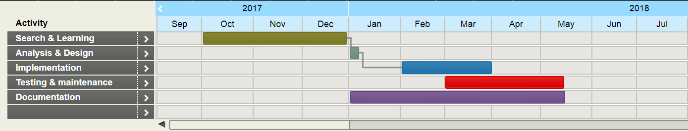
Time Plan
51

Slide 75
Outline
Introduction
Problem definition
Working Phases
Progress
Time Plan
Tools
52

Slide 76
Tools
Languages:
Python for preprocessing the datasets.
Javascript for the UI (optional).
Libraries and Frameworks:
NLTK, Pillow (Python Imaging Library) for preprocessing the dataset.
TensorFlow to build the model.
53

Slide 77
Outline
Introduction
Problem definition
Working Phases
Time Plan
Tools
References
47

Slide 78
References
Chenyue Meng and Yixin Wang, “Image-Question-Linguistic Co-Attention for Visual Question Answering”, 2016.
Alisha Rege and Payal Bajaj C, “From Vision to NLP: A Merge”, 2017.
Ronghang Hu and Jacob Andreas and Marcus Rohrbach, “Learning to Reason: End-to-End Module Networks for Visual Question Answering” , 2017.
Jiasen Luand Jianwei Yang and Dhruv Batra , “Hierarchical Question-Image Co-Attention for Visual Question Answering” , 2017
48

Slide 79
Questions
49

Slide 80
Thank You!
50

